Slide 1






CSEP 590tv: Quantum Computing
Dave Bacon
July 27, 2005
Today’s Menu
David
Deutsch
Richard
Jozsa
Administrivia
Function Evaluation
Umesh
Vazirani
Ethan
Bernstein
Deutsch-Jozsa Algorithm
Bernstein-Vazirani Algorithm
Simon’s Algorithm
Dan
Simon
Begin Shor’s Algorithm
Peter
Shor

Slide 2
Administrivia
Turn in HW #4.
Pick up HW #5.
“Difficulty”
#1
#2
#3
#4
#5
#6
Final

Slide 3

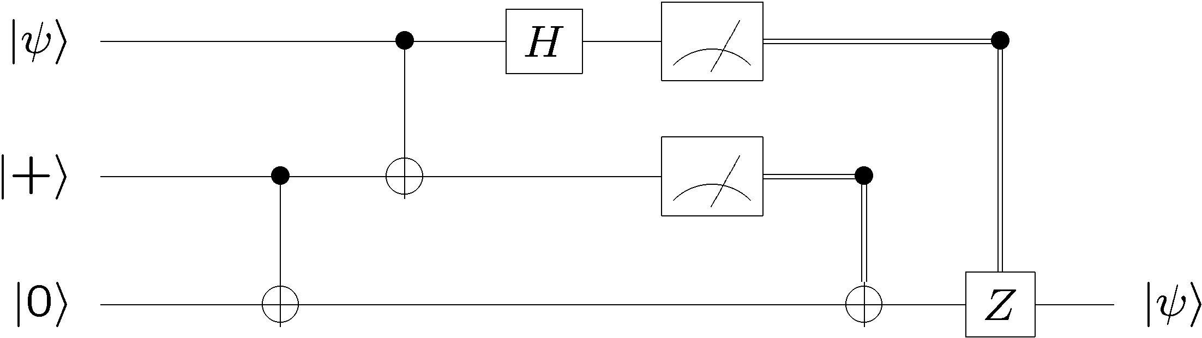

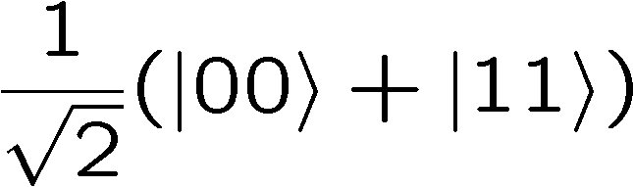



Recap
Quantum teleportation:
Bell basis measurement
Alice
50 % 0, 50 % 1
50 % 0, 50 % 1
Bob
Quantum superdense coding:
Bell basis
measurement

Slide 4


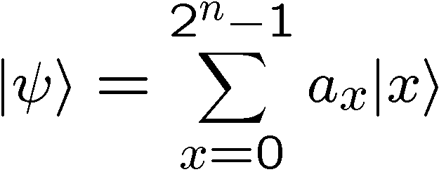
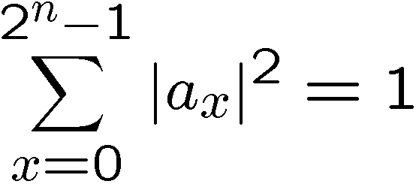
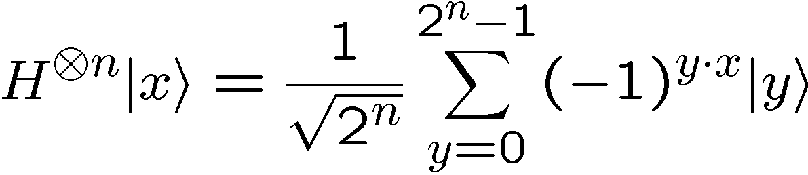
Recap
n qubit computational qubit basis:
n bit string
n qubit computational qubit wave functions:
n qubit Hadamard:

Slide 5
Recap
n qubit computational qubit basis:
n bit string
n qubit computational qubit wave functions:
n qubit Hadamard:

Slide 6
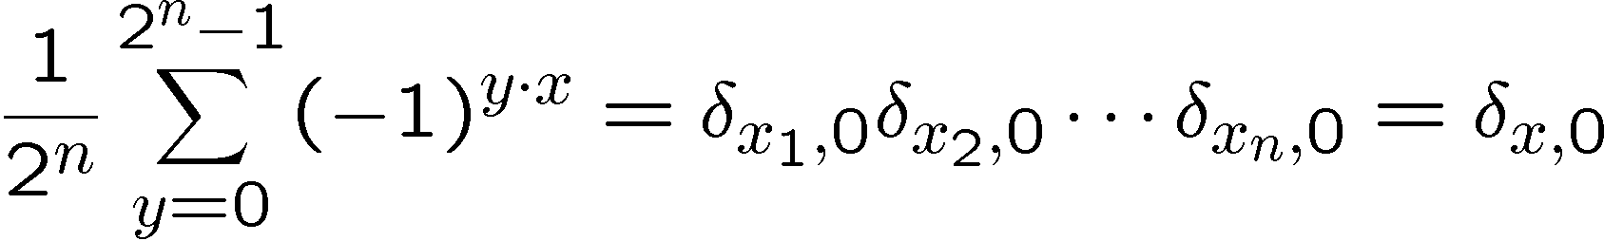
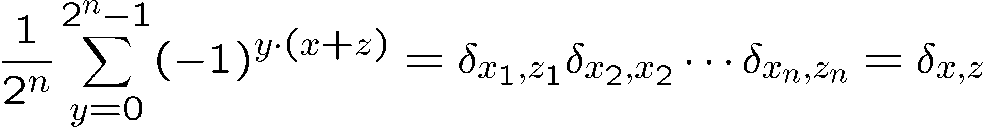
Recap
Hadamard orthogonality relationship:
or

Slide 7
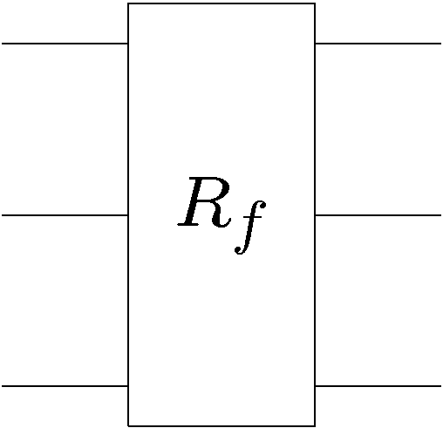





Classical Promise Problem
Query Complexity
Given: A black box which computes some function
k bit input
k bit output
black box
Promise: the function belongs to a set which is a subset
of all possible functions.
Properties: the set can be divided into disjoint subsets
Problem: What is the minimal number of times we have to
use (query) the black box in order to determine which subset
the function belongs to?

Slide 8
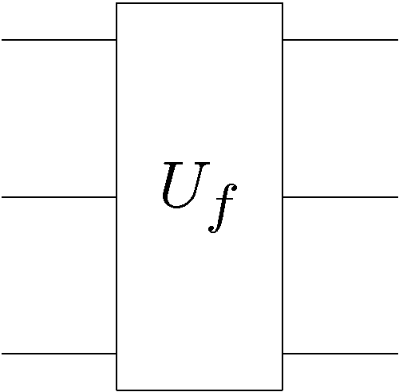

Quantum Promise Query Complexity
Given: A quantum gate which, when used as a classical device
computes a reversible function
k qubit input
k qubit output
black box
Promise: the function belongs to a set which is a subset
of all possible functions.
Properties: the set can be divided into disjoint subsets
Problem: What is the minimal number of times we have to
use (query) the quantum gate in order to determine which
subset the function belongs to?

Slide 9
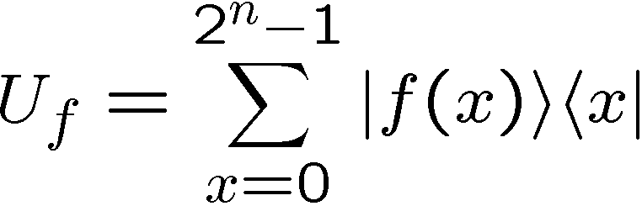
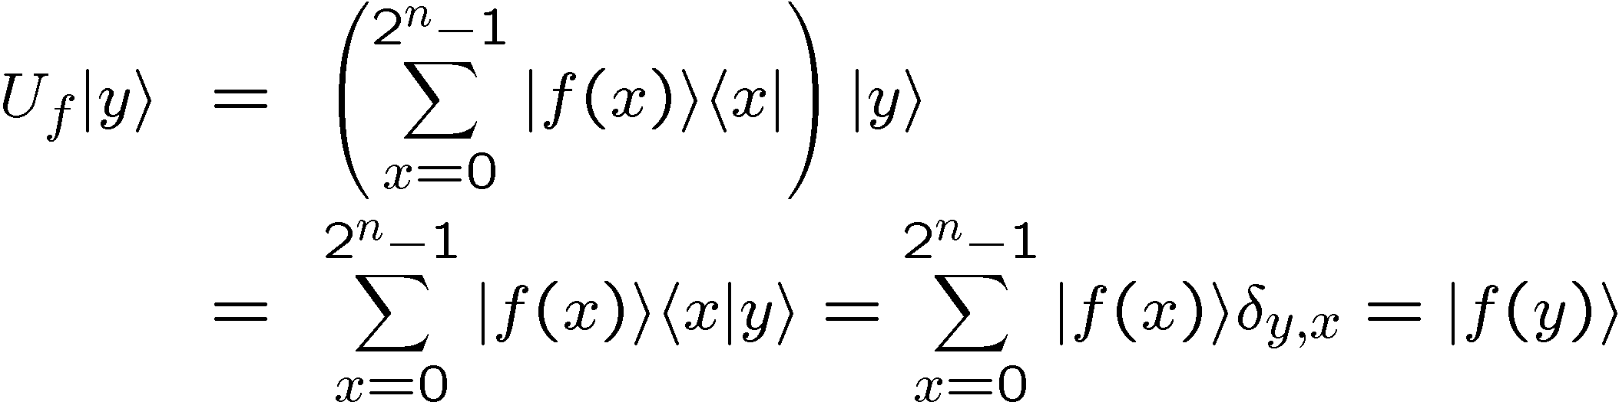
Functions
We can write the unitary
k qubit input
k qubit output
black box
in outer product form as
so that

Slide 10
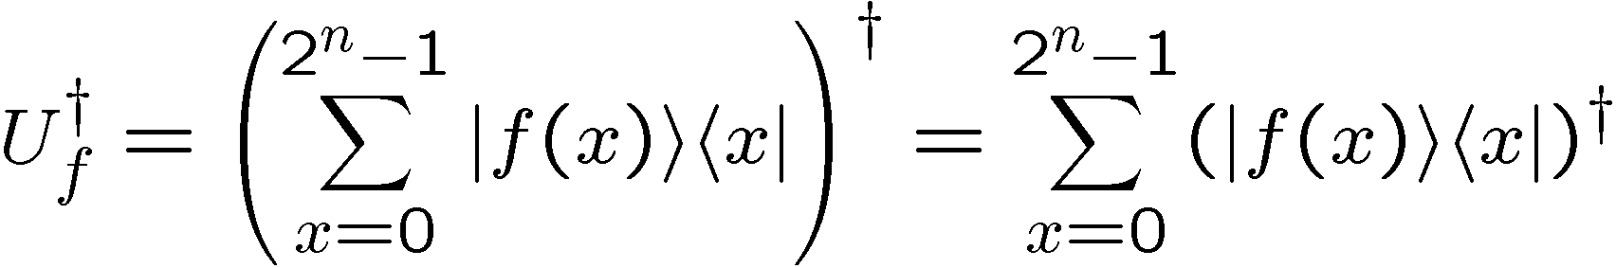
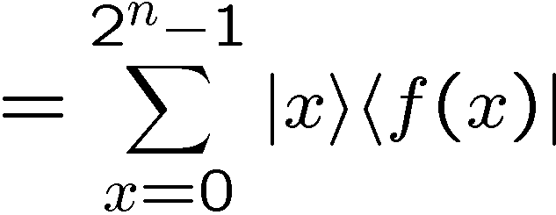
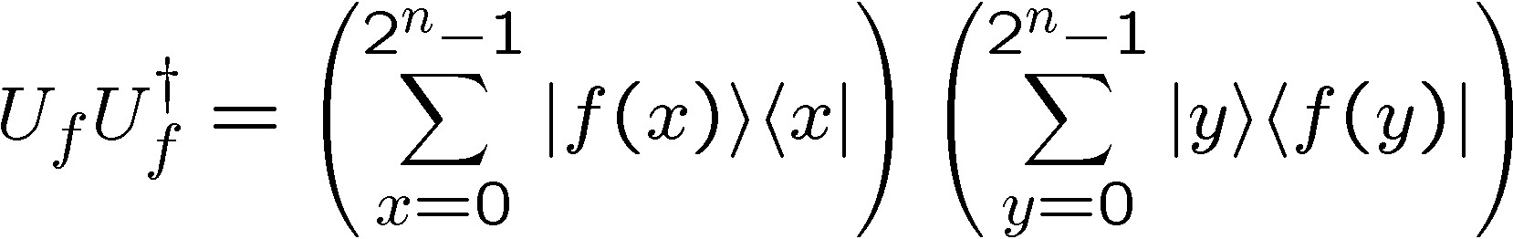
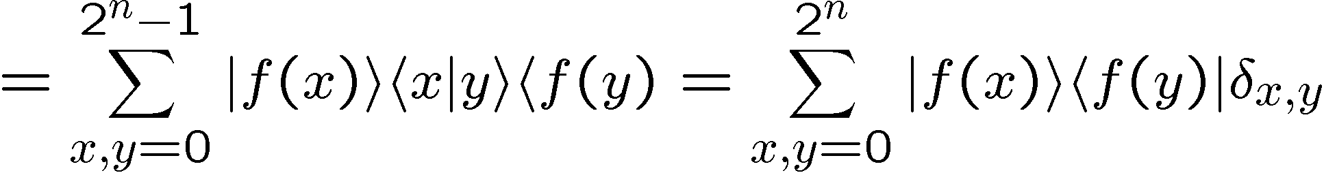
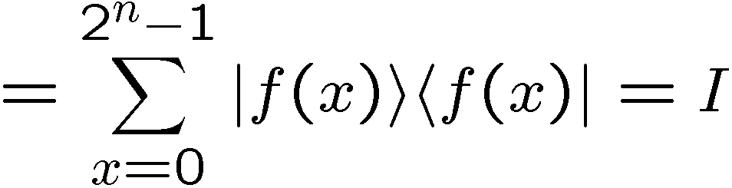
Functions
Note that the transform is unitary
When
precisely when f(x) is
one to one!

Slide 11






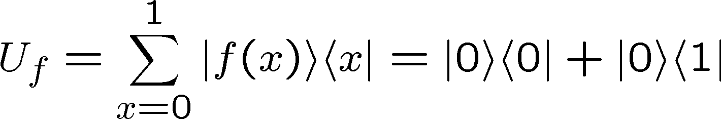
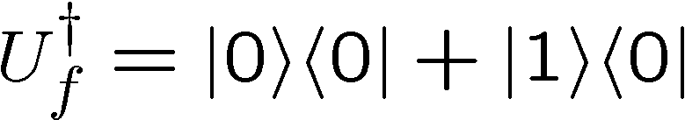
Functions
One to one
Example:
Not one to one:

Slide 12



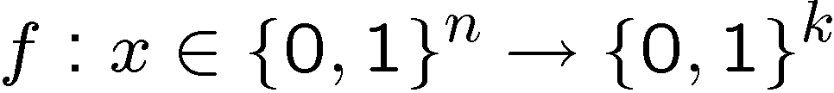
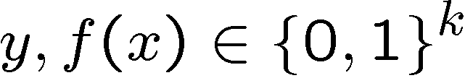




An Aside on Functions
Generically we can compute a non-reversible function using
the following trick:
n qubits
function from n bits
to k bits:
k qubits
is a bitwise exclusive or
Such that, with proper input we can calculate f:
ancilla

Slide 13
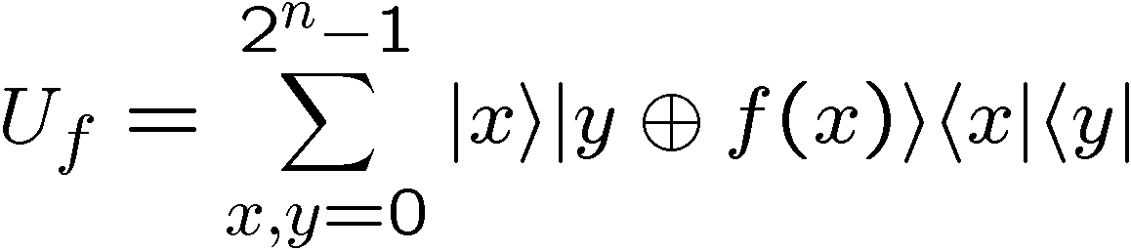
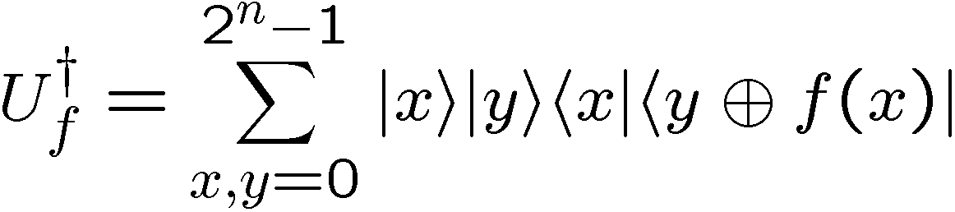
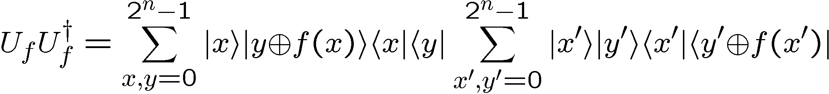
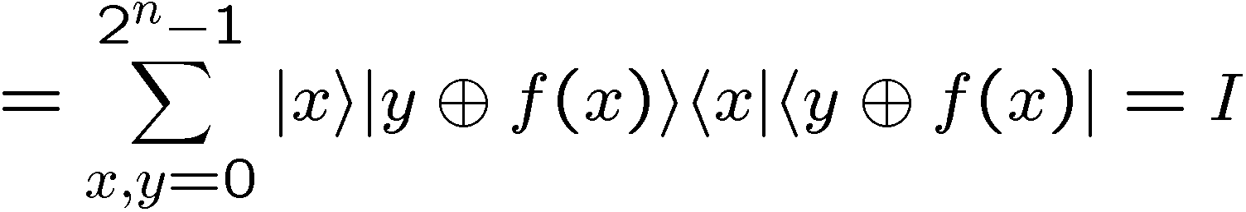
An Aside on Functions
function from n bits
to k bits:
n qubits
k qubits
is a bitwise exclusive or

Slide 14








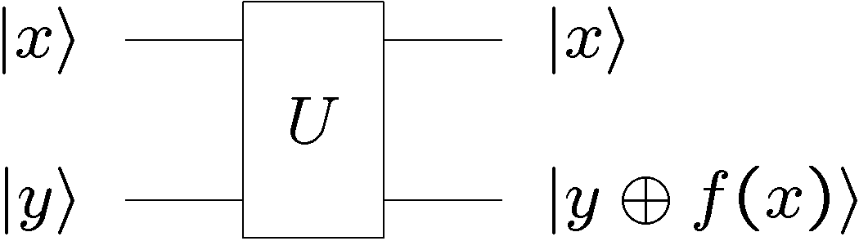




From This Perspective
controlled-NOT
+ NOT 2nd bit
“identity”
NOT 2nd bit
controlled-NOT
constant functions
balanced functions
Deutsch’s problem is to distinguish constant from balanced

Slide 15
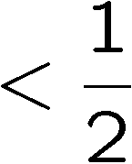
Query Complexities
black box
probability
of failure
Exact classical
query complexity
Bounded error algorithms are allowed to fail with a bounded probability of failure.
Bounded error classical
query complexity
Exact quantum
query complexity
Bounded error quantum
query complexity

Slide 16




Quantum Algorithms
1992: Deutsch-Jozsa Algorithm
Exact classical q. complexity:
David
Deutsch
Richard
Jozsa
Bounded error classical q. complexity:
Exact quantum q. complexity:
1993: Bernstein-Vazirani Algorithm
(non-recursive)
Exact classical q. complexity:
Umesh
Vazirani
Ethan
Bernstein
Bounded error classical q. complexity:
Exact quantum q. complexity:

Slide 17


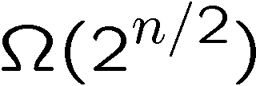

Quantum Algorithms
1993: Bernstein-Vazirani Algorithm
(recursive)
Bounded error classical q. complexity:
Umesh
Vazirani
Ethan
Bernstein
Exact quantum q. complexity:
(first super-polynomial separation)
1994: Simon’s Algorithm
Bounded error classical q. complexity:
Dan
Simon
Bounded error quantum q. complexity:
(first exponential separation)
Generalizing Simon’s algorithm, in 1994, Peter Shor was able
to derive an algorithm for efficiently factoring and discrete log!

Slide 18
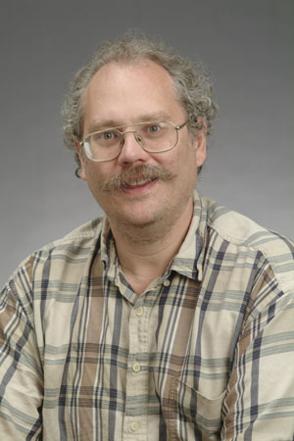


The Factoring Firestorm
18819881292060796383869723946165043
98071635633794173827007633564229888
59715234665485319060606504743045317
38801130339671619969232120573403187
9550656996221305168759307650257059
Peter
Shor
1994
3980750864240649373971
2550055038649119906436
2342526708406385189575
946388957261768583317
4727721461074353025362
2307197304822463291469
5302097116459852171130
520711256363590397527
Best classical algorithm
takes time
Shor’s quantum algorithm
takes time
An efficient algorithm for factoring breaks the
RSA public key cryptosystem

Slide 19

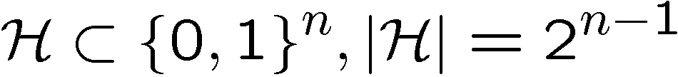

Deutsch-Jozsa Problem
Given: A function with n bit strings as input and one bit as
output
(this will be a non-reversible function)
Promise: The function is either constant or balance.
constant function:
balanced function:
constant
balanced
Problem: determine whether the function is constant or
balanced.

Slide 20
Classical Deutsch-Jozsa
constant
balanced
Problem: determine whether the function is constant or
balanced.
No failure allowed: we need to query in the worst case
values of to distinguish between constant and
balanced
Exact classical q. complexity:

Slide 21
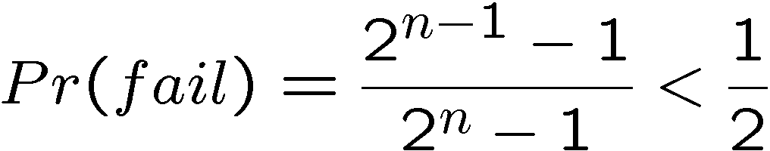
Classical Deutsch-Jozsa
constant
balanced
Problem: determine whether the function is constant or
balanced.
Bounded error:
Query two different random values of
the function.
If they are equal, guess constant.
Otherwise, guess balanced.
Bounded error classical q. complexity:

Slide 22

Quantum Deutsch-Jozsa
Given: A quantum gate on n+1 qubits strings which calculates
the promised f
n qubit
1qubit

Slide 23
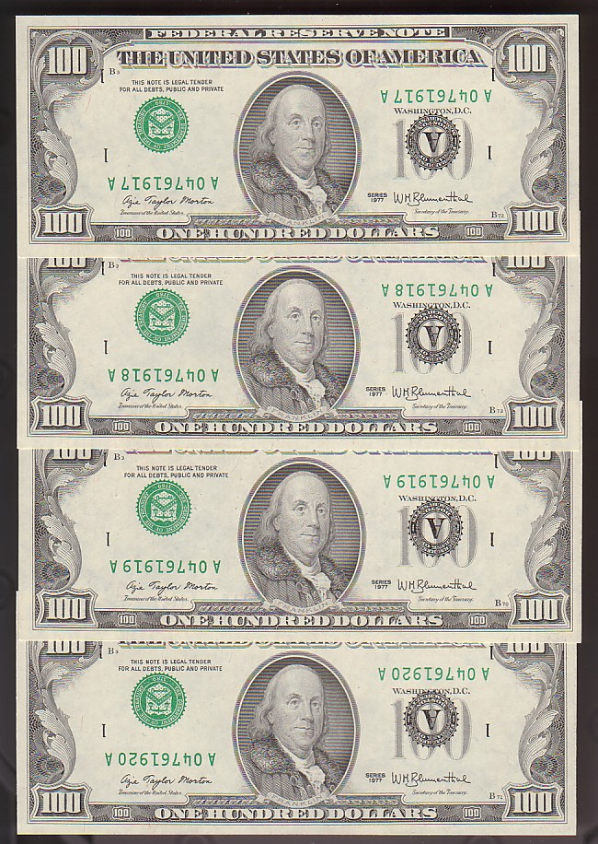
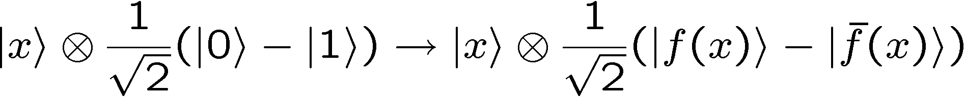
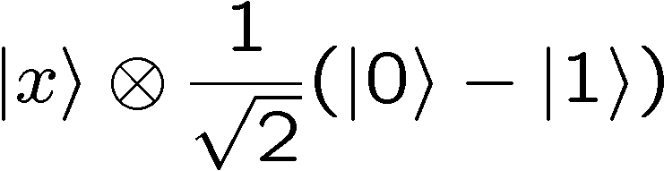
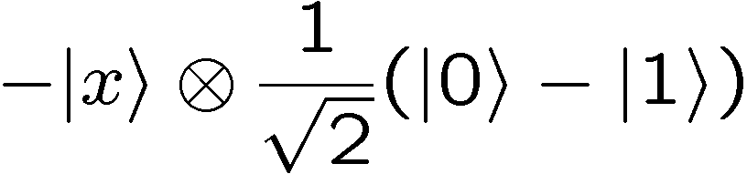
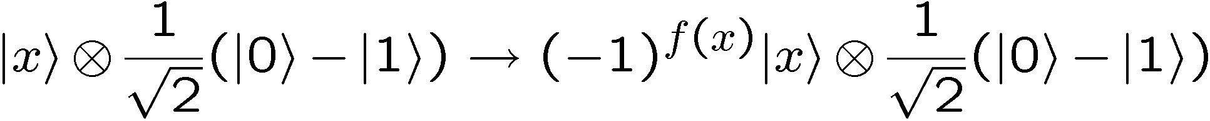
Trick 1: Phase Kickback
Input a superposition over second register:
Function is computed into phase:

Slide 24
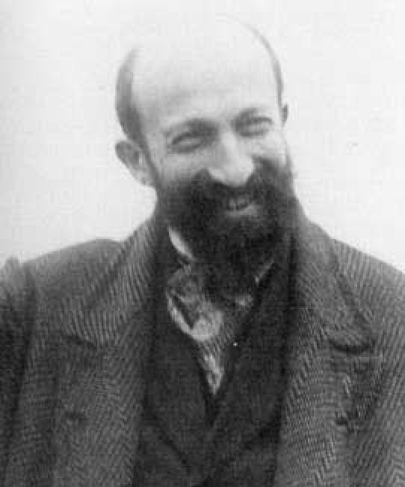
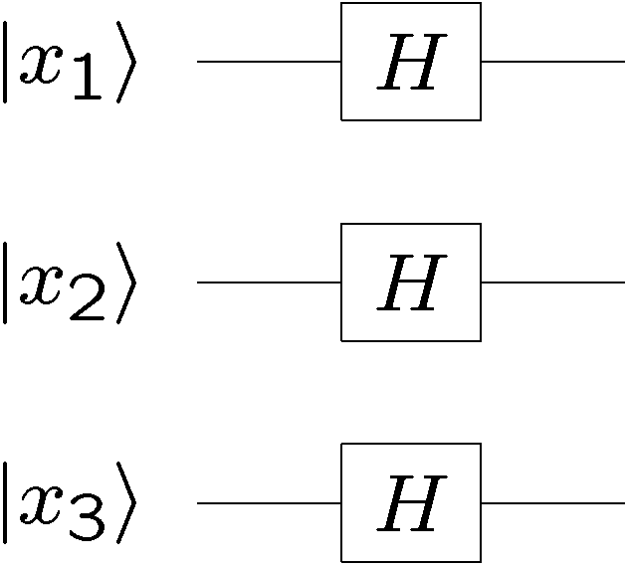
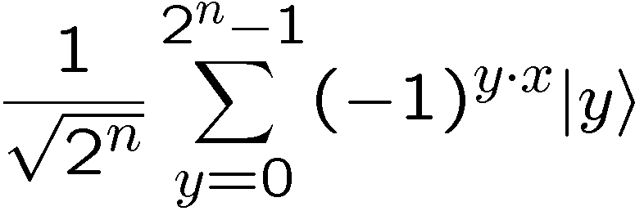

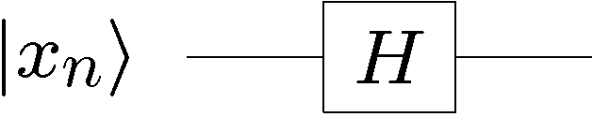
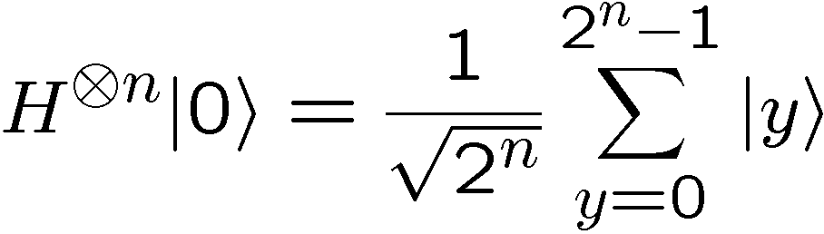
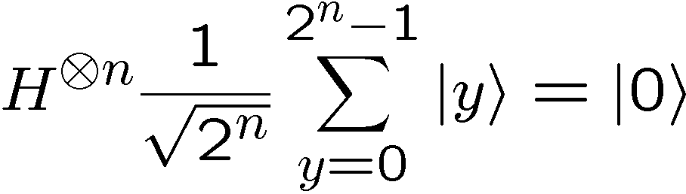
Trick 2: Hadamarding Qubits
Note:
and

Slide 25
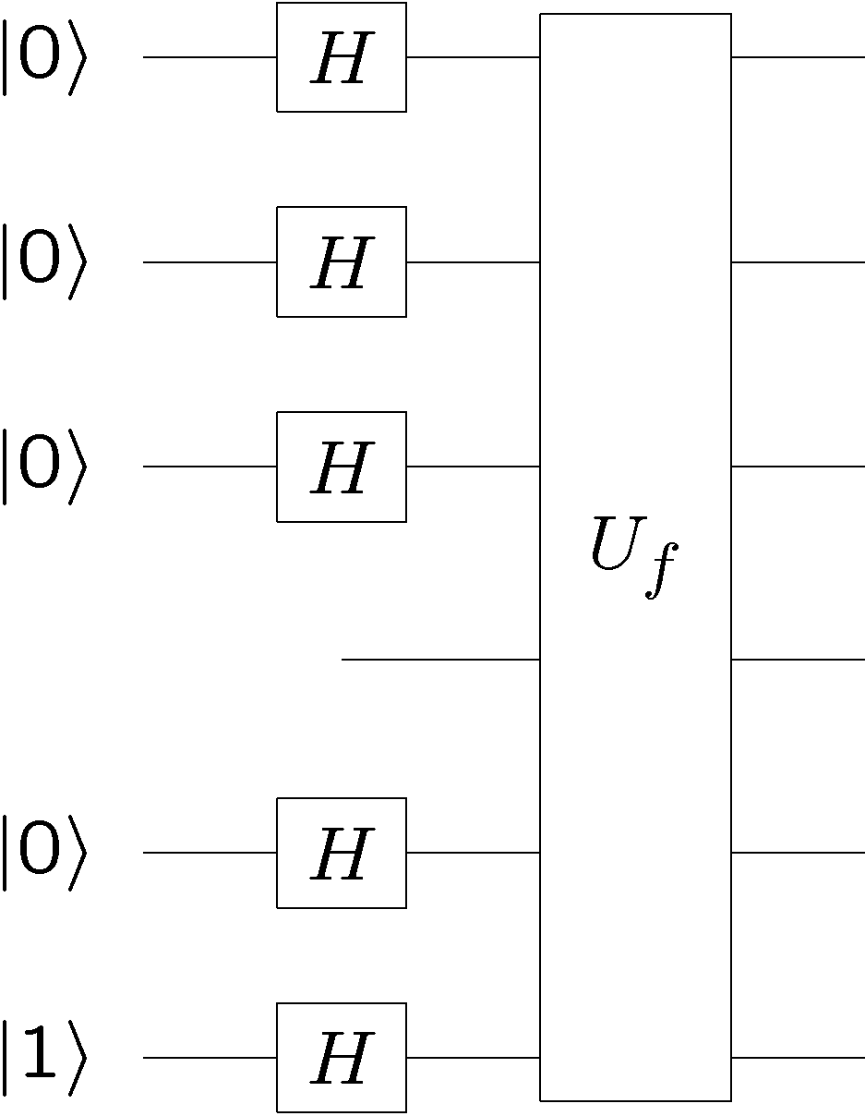

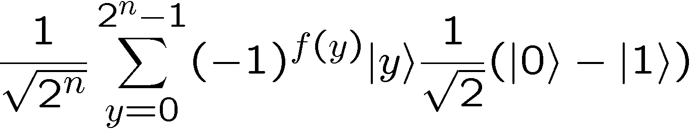
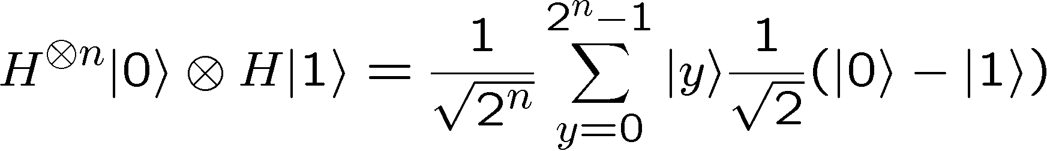
Tricks 1 and 2 Together
n
qubits

Slide 26
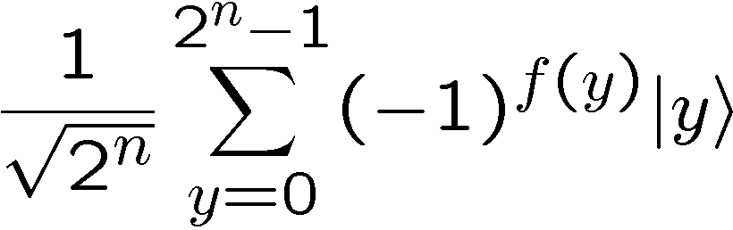
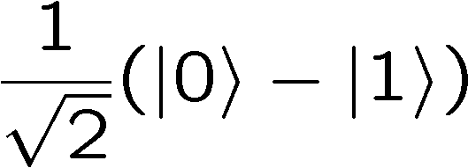
Tricks 1 and 2 Together
n qubits

Slide 27
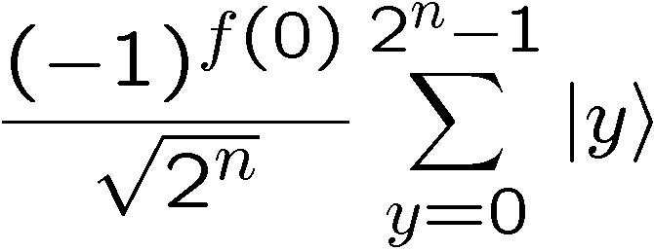
Function in the Phase
constant
balanced

Slide 28
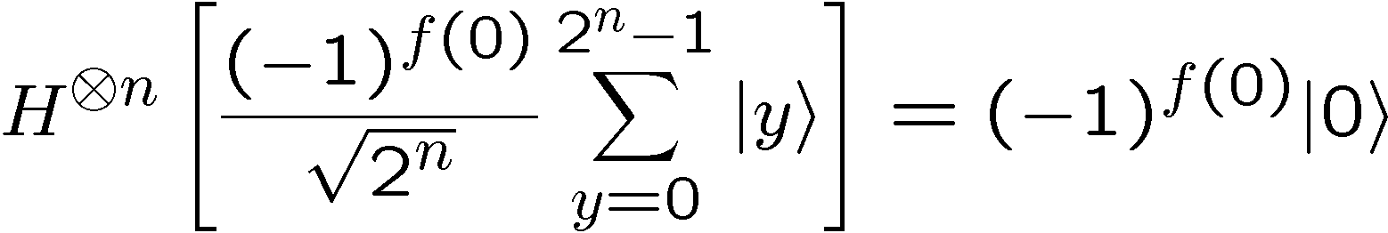
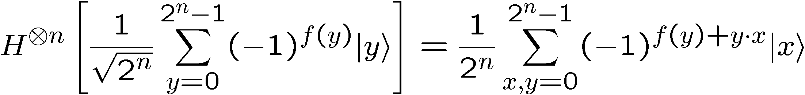
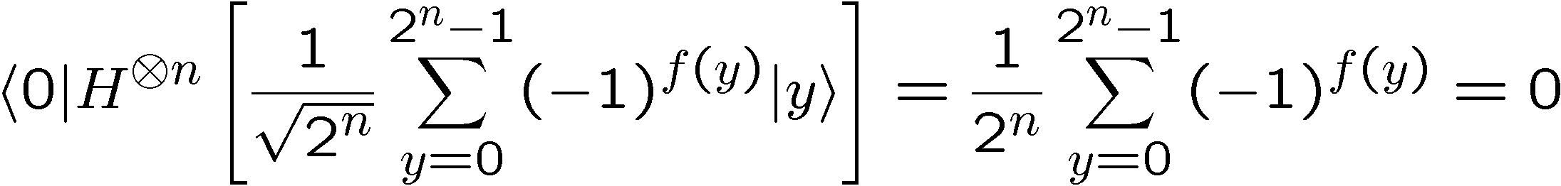
Function in the Phase
When the function is constant:
When the function is balanced:
amplitude in zero state

Slide 29


Quantum Deutsch-Jozsa
n
qubits
If function is constant, r is always 0.
If function is balanced, r is never 0.
Distinguish constant from balanced using one quantum query

Slide 30
Deutsch-Jozsa
1992: Deutsch-Jozsa Algorithm
Exact classical q. complexity:
David
Deutsch
Richard
Jozsa
Bounded error classical q. complexity:
Exact quantum q. complexity:

Slide 31




Bernstein-Vazirani Problem
Given: A function with n bit strings as input and one bit as
output
Promise: The function is of the form
Problem: Find the n bit string

Slide 32
Classical Bernstein-Vazirani
Given: A function with n bit strings as input and one bit as
output
Promise: The function is of the form
Problem: Find the n bit string
Notice that the querying yields a single bit of information.
But we need n bits of information to describe .
Bounded error classical q. complexity:

Slide 33

Quantum Bernstein-Vazirani
n qubits

Slide 34




Hadamard It!

Slide 35
Quantum Bernstein-Vazirani
n
qubits
We can determine using only a single quantum query!

Slide 36
Bernstein-Vazirani
1993: Bernstein-Vazirani Algorithm
(non-recursive)
Exact classical q. complexity:
Umesh
Vazirani
Ethan
Bernstein
Bounded error classical q. complexity:
Exact quantum q. complexity:

Slide 37
In Class Problem #1

Slide 38




Simon’s Problem
(is that nobody does what Simon says)
Given: A function with n bit strings as input and one bit as
output
Promise: The function is guaranteed to satisfy
Problem: Find the n bit string

Slide 39






Classical Simon’s Problem
Promise: The function is guaranteed to satisfy
Suppose we start querying the function and build up a list
of the pairs
If we find such that then we solve the
problem:
But suppose we start querying the function m times….
Probability of getting a matching pair
Bounded error query complexity:

Slide 40

Quantum Simon’s Problem
black box
Unlike previous problems, we can’t use the phase kickback
trick because there is no structure in the function.
Charge ahead:

Slide 41



Quantum Simon’s Problem
n qubits
n qubits

Slide 42


Quantum Simon’s Problem
Measure the second register
Using the promise on the function
This implies that after we measure, we have the state
For random uniformly distributed
uniformly distributed = all strings equally probable
Measuring this state at this time does us no good….

Slide 43


Quantum Simon’s Problem
Measuring this state in the computational basis at this time
does us no good….
For random uniformly distributed
Measurement yields either
or
But we don’t know x, so we can’t use this to find s.

Slide 44


Quantum Simon’s Problem
n qubits
n qubits

Slide 45




Quantum Simon’s Problem
Measuring this state, we obtain uniformly distributed random
values of such that
If we have eliminated the possible values of by half

Slide 46









Quantum Simon’s Problem
On values of which are 0, this doesn’t restrict
On values of which are 1, the corresponding must
XOR to 0. This restricts the set of possible ‘s by half.
Example:
possible ‘s:

Slide 47




(Z₂)^{n} Vectors
If single run eliminates half, multiple runs….how to solve?
Think about the bit strings as vectors in
vectors in
We can add these vectors:
Where all additions are done module 2

Slide 48






(Z₂)^{n} Vectors
Example:
We can multiply these vectors by a scalar in
Example:

Slide 49


(Z₂)^{n} Vectors
dot product of vectors in
Example:

Slide 50



(Z₂)^{n} Vectors
vectors in
one possible basis:

Slide 51





(Z₂)^{n} Vectors
vectors in
But we can expand in about a different set of vectors
Example:

Slide 52



(Z₂)^{n} Vectors
vectors in
But we can expand in about a different set of vectors
When these n vectors are linearly independent
linearly independent
linearly dependent

Slide 53




Quantum Simon’s Problem
Think about the bit strings as vectors in
Multiple runs of the quantum algorithm yield equations
random
uniform
If we obtain linearly independent equations of this form,
we win (Gaussian elimination)

Slide 54



(Z₂)^{n} Vectors
Notice that if y is one of vectors with only one 1:
th bit
then this implies
Notice that if y is one of vectors with only one two 1’s:
then this implies or

Slide 55

(Z₂)^{n} Gaussian Elimination
is equivalent to (remember, we know the y’s)

Slide 56

(Z₂)^{n} Gaussian Elimination
We can add rows together to get new equations
We can always relabel the and correspondingly

Slide 57
(Z₂)^{n} Gaussian Elimination
Using these two techniques it is always possible to change
the equations to the form:
Where the prime indicates that the may have been permuted.
Depending on the v’s this allows us to find the

Slide 58










(Z₂)^{n} Gaussian Elimination
Example:
already in correct form
add all three equations
already in correct form
solutions:

Slide 59
In Class Problem 2

Slide 60




Quantum Simon’s Problem
Think about the bit strings as vectors in
Multiple runs of the quantum algorithm yield equations
random
uniform
If we obtain linearly independent equations of this form,
we win (Gaussian elimination)
Suppose we have linearly independent ‘s. What is the
probability that is linearly independent of previous ‘s?

Slide 61


Quantum Simon’s Problem
What is the probability that our equations are linearly
independent?
With constant probability we obtain linearly independence and
hence solve Simon’s problem.

Slide 62
Simon’s Problem
1994: Simon’s Algorithm
Bounded error classical q. complexity:
Dan
Simon
Bounded error quantum q. complexity:
(first exponential separation!)

Slide 63

Pooh-Pooh?
People like to pooh-pooh these early problems because they
do not solve problems which are “natural”
This is silly. These results show that treating a device as
classical or as quantum show amazing differences.

